Slide 1
The Effect of Composition Sequence on a Filter toward Acidity Level in Grey water
Present by:
Wildan Akbar Fauzan
Anis Rahmawati
Taufiq Lilo Adi Sucipto
M. Kunta Biddinika

Slide 2
About our research team
Present by:
Wildan Akbar Fauzan
Anis Rahmawati
Taufiq Lilo Adi Sucipto
M. Kunta Biddinika

Slide 3
Background of the Problem
Water Pollution
Gravel
Sand
Water Filter
Charcoal
Palm Fiber
Composition Sequence
Acidity Level

Slide 4
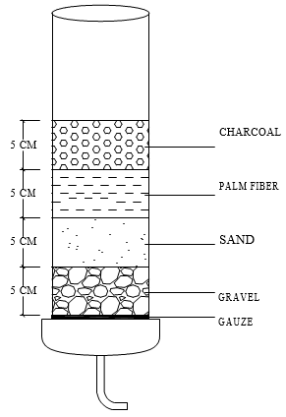
Research and methods
Figure the material composite
The construction of grey water filter

Slide 5
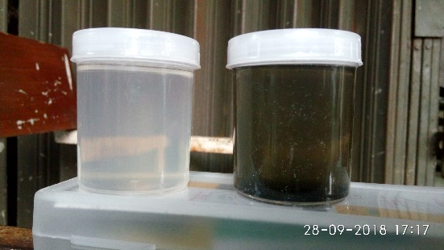
Result
1. First trial
Filtered
water
Raw water
In the first trial of grey water filter production, all materials used were prior not washed.

Slide 6
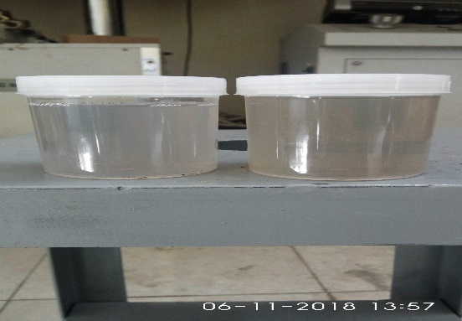
Result
2. Second trial
Raw water
Filtered
water
Filtered
water
In the second trial, all the materials were washed before used in filter

Slide 7
Acidity Test Result
No | Composition Sequence from bottom to top | Acidity Level (pH)
 |  | First Test | Second Test
1 | Sand-Gravel-Charcoal-Palm fiber | 9.50 | 9.20
2 | Sand-Gravel-Palm fiber-Charcoal | 9.48 | 9.10
3 | Sand-Charcoal-Palm fiber-Gravel | 9.51 | 9.30
4 | Sand-Charcoal-Gravel-Palm fiber | 9.28 | 9.00
5 | Charcoal-Gravel-Palm fiber-Sand | 9.39 | 9.20
6 | Charcoal-Gravel-Sand-Palm fiber | 8.99 | 9.00
7 | Charcoal-Sand-Palm fiber-Gravel | 9.34 | 9.10
8 | Charcoal-Sand-Gravel-Palm fiber | 9.10 | 8.90

Slide 8
Acidity Test Result
No | Composition Sequence from bottom to top | Acidity Level (pH)
 |  | First Test | Second Test
9 | Palm fiber-Sand-Gravel-Charcoal | 9.21 | 9.00
10 | Palm fiber-Sand-Charcoal-Gravel | 9.35 | 9.10
11 | Palm fiber-Gravel-Charcoal-Sand | 9.28 | 9.00
12 | Palm fiber-Gravel-Sand-Charcoal | 8.78 | 8.70
13 | Gravel-Sand-Charcoal-Palm fiber | 8.73 | 8.70
14 | Gravel-Sand-Palm fiber-Charcoal | 8.67 | 8.60
15 | Gravel-Charcoal-Sand-Palm fiber | 8.98 | 8.90
16 | Gravel-Palm fiber-Charcoal-Sand | 8.71 | 8.70

Slide 9
Conclusion and Recommendation
The different sequence of material composition generate different acidity level (pH)
The material need to wash before used

