Slide 1
Developing FinTech and Islamic Finance Products
in Agricultural Value Chain
R. Gratiyana Ningrat
University of Indonesia, Indonesia, r.gratiyana@ui.ac.id
Mohammad Soleh Nurzaman, Ph.D
University of Indonesia, Indonesia, dedenmsn@gmail.com

Slide 2
The purpose of the study
To propose a sharia compliant community based and institutional financing with FinTech enabled which integrating all actors (suppliers, farmers, brokers, retailers, investor, institutions) into an Islamic value chain financing.
By Dominica Roseclay

Slide 3
Rural market program
1st Sample
Crowde Agri-FinTech
2nd Sample
A multi-year public private partnership in agriculture rural market development which established since 2013
Adopts a market system development and agricultural value chain finance approach
Aiming to benefit one million smallholder farming households in eastern Indonesia.
Crowde, an ecosystem builder for digitizing agricultural process from upstream to downstream through peer-to-peer lending mechanism established since 2015.
Crowde has disbursed fund to 10,000 farmers mostly in West of Indonesia from 22,400 lenders in 2018.

Slide 4
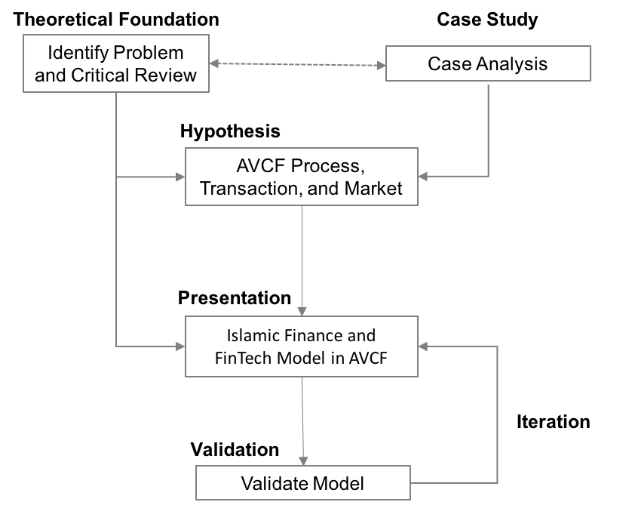
Methodology Case Study
Why agricultural value chain finance approach?
How is the agricultural value chain finance practice in the market?
What are current AVCF products and how is the transaction?
Data Collection. Krippendorff (2004), Yin (2014) & (Lincoln & Guba, 1985)
Coding and Data Analysis. Krippendorff (2004)
Figure 1. Case Study Analysis Process by Authors

Slide 5
By Snapwire
Problems
“How Islamic finance give solution to agricultural value chain financing in FinTech enabled platform?”

Slide 6
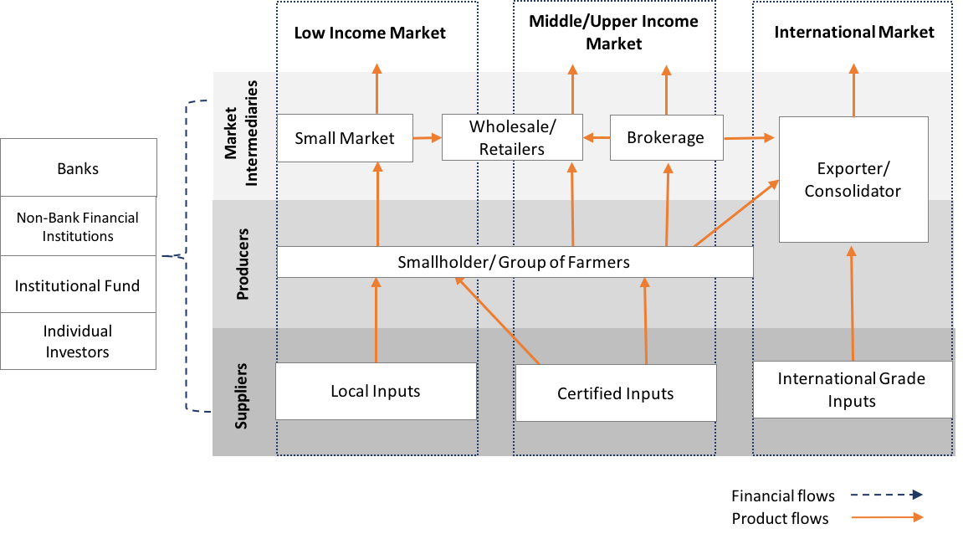
The smallholder farmers linking into three different market segment.
Source: Compiled by Authors’, 2019
Figure 2. Segmented Agriculture’s Value Chain Finance

Slide 7
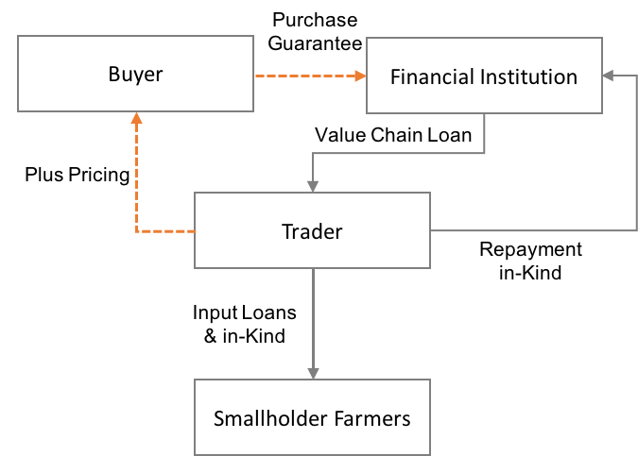
Internal financing between actors already happened in form of traditional supply chain.
Source: Compiled by Authors’, 2019
Figure 3. Common Value Chain Financing Mechanism

Slide 8
Major
Findings
Development Program
To build market system in AVCF, they find the strongest actors, less risk, and have social value based driven to build a partnership (Miller & Jones, 2010).
All financial products are using conventional loan, where the farmers can be disadvantaged by loan shark (Sugema, Bakhtiar, & Effendi, 2010).
The credit scoring process is still acquired manually from value chain actors’ memory or unstandardized paper notes.

Slide 9
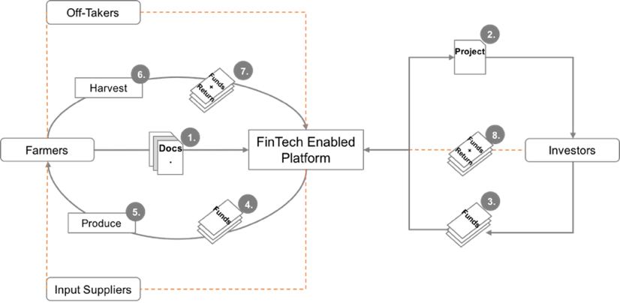
Crowde have field officer to ensure the external financing process.
Source: Crowde, 2018
Figure 4. FinTech Enabled Platform in Agriculture

Slide 10
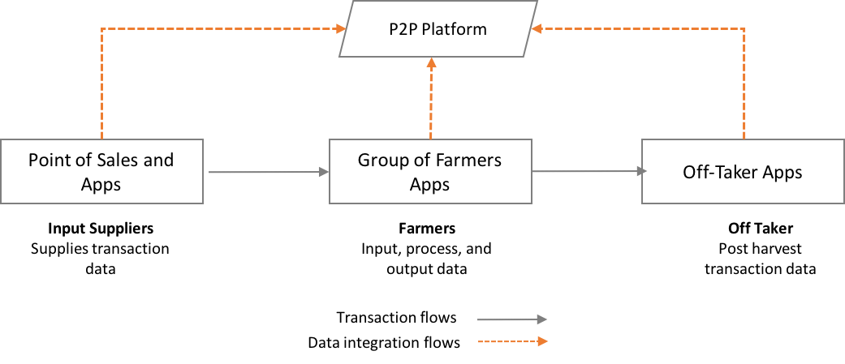
In the process of integrating data from input supplier, farmer, and off taker.
See pg. 9
The credit scoring process is still acquired manually from value chain actors’ memory or unstandardized paper notes.
Source: Compiled by Authors’, 2019
Figure 5. Data Flows in FinTech Enabled Platform

Slide 11
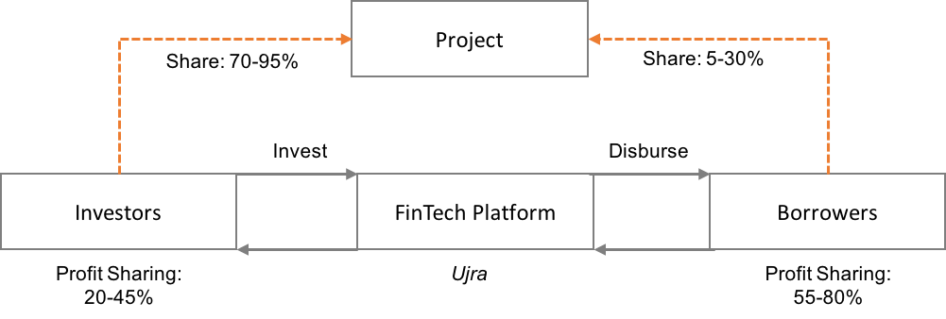
A gap to provide access to finance to the low market segment.
Recently developing Islamic financing product, but still low adoption from farmers’ side

Slide 12
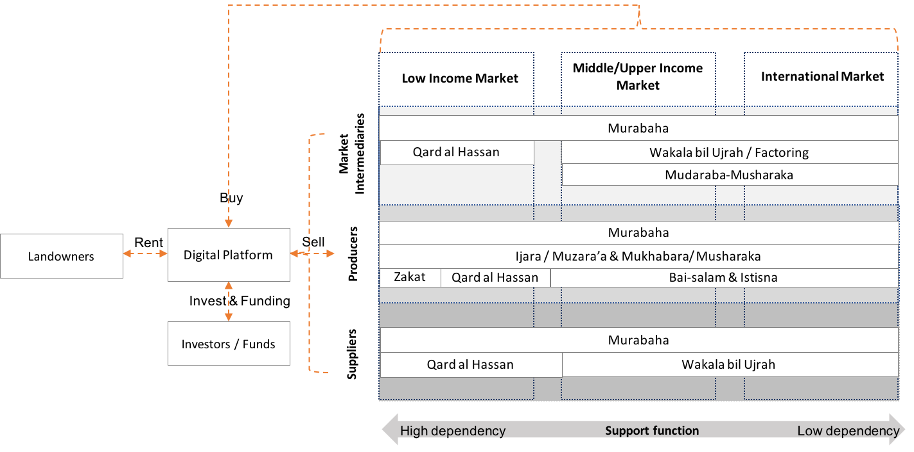
AVCF-IF Platform
Source: Compiled by Authors’, 2019
Figure 6. Islamic Agriculture’s Value Chain Finance Products with FinTech Enabled Platform

Slide 13
Policy Implications
Determining behavioral intention for AVCF Islamic FinTech products.
Development of technology support and architecture. (Lynn et al., 2019).
Partnership establishment of extension services and support entities. (OECD, 2018; Rode et al., 2019).

Slide 14
Conclusion and Recommendation
This study emphasizes in the era of Fourth Industrial Revolution; digital technologies can be the solution to emerging social problems and one of them is agriculture and undoubtedly essentials to spur its growth and sustainable development.
This study suggest that Islamic finance can contribute its financial development to all market segmentation and value chain actors from various fund sources and stakeholders.
Additionally, determining buying intention, partnership establishment, and technology infrastructure are pivotal for its future implementation.

Slide 15
Q&A
Thank you for your attention!

